Slide 1

SG ❤ ENVIRONMENT FINAL PROJECT PRESENTATION
Name: Dharineesh Karthikeyan
Course: ALY 6060 – Decision Support and Business Intelligence

Slide 2
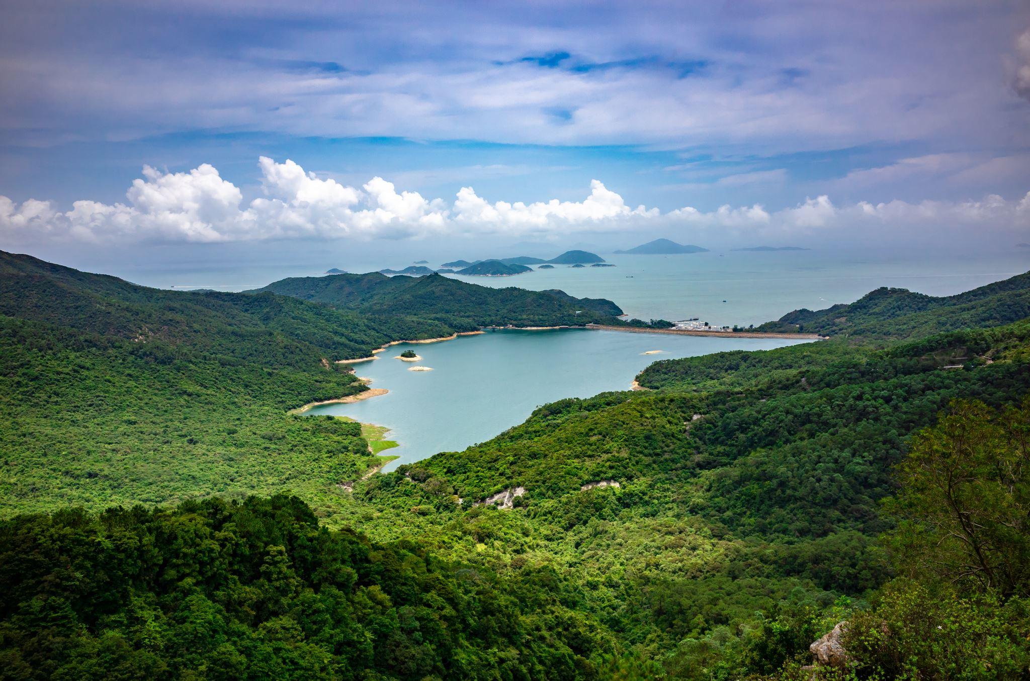
Introduction
Location:
Singapore is a tropical island in Southeast Asia. It's made up of the mainland and other islands.
Size:
Singapore is a very small country in terms of size, in comparison the United States is almost 13,600 times the size of Singapore.
Population:
It has a population of 6 million, which is a lot for a country of this size.
As of 2023, the population density of Singapore is 8592 per Km2 and stands 114th in the world!
Constraints:
Singapore is a highly urbanized city-state with a unique set of challenges and constraints, particularly its limited land area combined with a high population density.
Let’s look at how Singapore manages to contribute to saving nature and environment despite all these challenges.

Slide 3
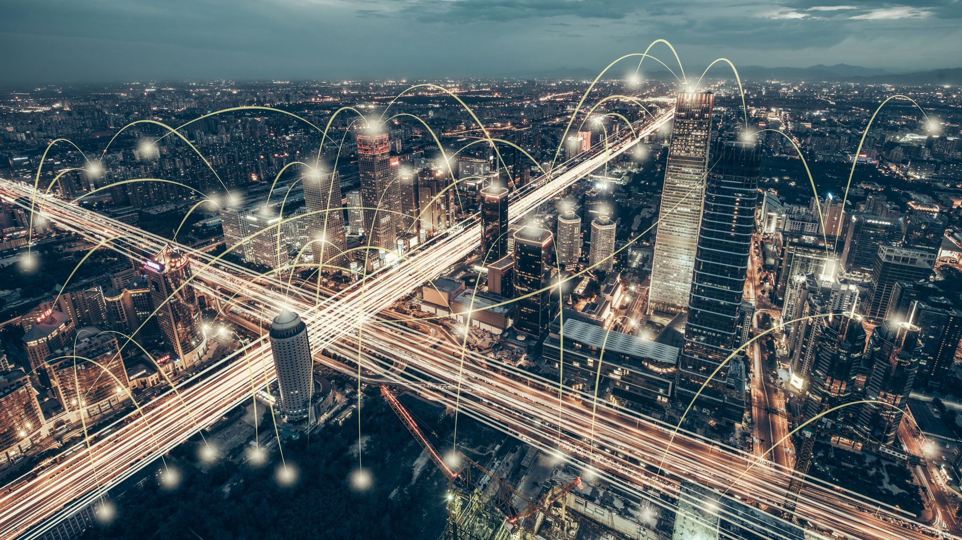
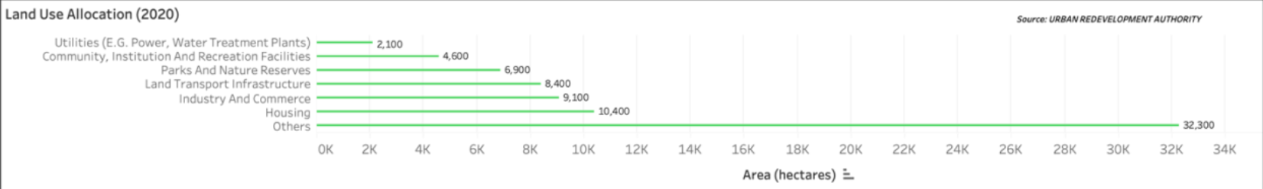
Land Management in Singapore
Singapore focuses on a balance between urban development and environmental conservation
Nature Conservation: 9.35% of land for parks and nature reserves, prioritizing biodiversity. Additional 6.23% of land for community and recreational facilities.
Sustainable Transport: 11.38% allocated to build a well-connected transport infrastructure and cycle paths throughout the city, promoting public transit and cycling.
Innovative Housing: A population of 6 million along with tourists within just 14.09% is only possible due to the high-density housing and mixed-area development plans.
Economic Prioritization: Singapore’s economy is built on top of industry and commerce and trades using 9 harbors and ports. Hence, 12.32% of land dedicated efficiently supports its economic growth and global trade activities.

Slide 4
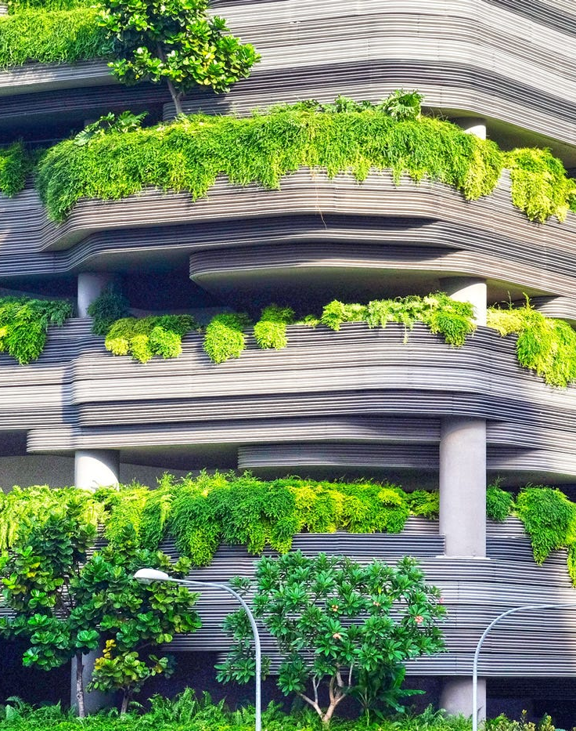
Additional Care For Environment Via Land
Urban Greenery:
Not just parks and reserves, Singapore incorporates greenery and nature into its urban areas through tree planting, rooftop gardens, vertical green spaces, and many more methods.
Efficient Utilities and Sources:
Singapore uses just 2.84% of land to provide for a huge population.
This is possible because about 95 per cent of Singapore's electricity is generated from natural gas.
A natural gas power plant has an approx. 1000 times lesser physical footprint when compared to other popular sources like coal and nuclear power plants.
Renewable Energy Sources:
Natural gas is a cleaner energy source compared to other options but not 100% clean.
Hence, Singapore has always been invested in renewable energy sources from solar, wind and hydrogen.
Singapore believes that solar power is the most promising energy source as they are located closer to the equator.
This Photo by Unknown Author is licensed under CC BY-SA-NC

Slide 5
My Suggestions for Singapore
Urban Farming Initiatives
Only 1 percent of land in Singapore is being used for agriculture, this increases the demand for food importation.
Government must promote agriculture and use vacant spaces to increase local food production and reduce the carbon footprint associated with food importation.
Smart Transportation Systems
Invest in smart transportation solutions, such as traffic flow optimization and demand-responsive public transit.
If we can access the demand of public transport and automatically reroute the buses and trains, we will be able to maximize the efficiency of existing infrastructure and minimize the need for new construction.
This also helps reduce the need for people choosing their own vehicles and reduces the emissions in the air.
Strict Environmental Impact Assessments (EIA)
All new developments must be made to follow a stricter EIA requirement.
The new EIA requirements must measure the environmental impact, incorporating considerations for biodiversity, water resources, and carbon footprint.
Incentivize Environment Friendly Plans
When new development projects for commercial or housing purposes are being developed, government can offer financial incentives for the inclusion of environment friendly plans such as using greener technologies of solar panels, energy-efficient lighting, water-saving fixtures.
This can help accelerate the greening of Singapore's city environment.

Slide 6

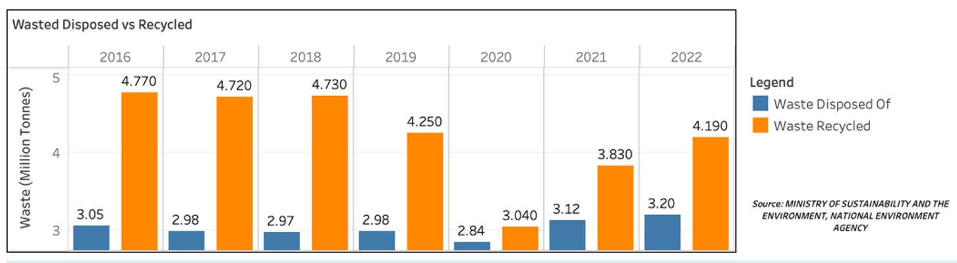
Waste Management Overview
Importance:
Waste management is crucial for maintaining public health and preserving the environment.
Recycling Goals:
Singapore is targeting to increase their recycling rates to 70% by 2030 and reduce waste sent to the landfill by 30%.
Landfill Constraints: Semakau landfill, the one and only landfill in Singapore is filling up in a rapidly vast speed and expected to fill by 2035.
Waste-to-Energy Plants:
This is one of the world's most advanced waste management systems and there are five Waste-to-Energy (WTE) plants in Singapore currently.
Lack of Sustainable Solutions:
Sadly, these efforts only help us delay the problem. Semakau landfill going to run out of space soon, and need for new WTE plants every 5-7 years to keep up with the waste generation.

Slide 7
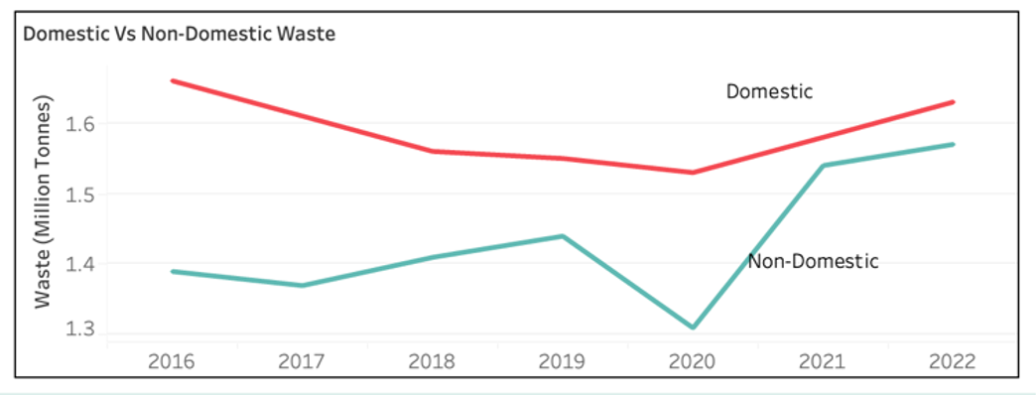
Waste Disposal and Recycling Trends (2016-2022)
Singapore distinguishes their waste as - Domestic waste (households waste) and non-domestic waste (industrial, commercial waste)
2016-2019: Analysis shows gradual decrease in waste generation.
2020 - Shows drop in Non-Domestic waste due to lack of industries during the pandemic
After 2021 – Alarming rates of increase in waste generation from Non-Domestic sources.

Slide 8
My Suggestions for Singapore
Invest in R&D
Research and adopt advanced technologies that can handle a wider variety of recyclables, including plastics that are currently not recyclable.
Invest more into the chemical recycling technology that Singapore is currently interested in. It might be the way to safely recycle and reuse plastics.
Zero-Waste Businesses
Zero-waste business is the concept of a business that creates no waste as part of their product, for example – package free products. Customers are interested only in the product but not the packaging and that ultimately goes to the waste.
Bring Your Own Bag Shopping
Right now, Singapore restricts the purchase of plastic bags to only Thursdays to Sundays but must follow this permanently. Jute bags or paper bags must be promoted instead.
E-Waste Management
I would argue that majority of the public lack’s proper knowledge regarding the dangers behind improper disposal of e-waste. The harmful toxic chemicals that are in them, end up affecting the soil, water, and air. Government can run campaigns to educate the public.
Hence, we can incentivize businesses that follow a zero-waste policy.
Government must limit or penalize the use of packaging for online ordering and delivery services.
Government must make it compulsory for people to bring their own bags for shopping and supermarkets or groceries stores must not be allowed to give or sell bags to the customers.
The government must establish e-waste collection points.
Government can try and encourage electronic manufacturers to take back old devices and reuse them to help reduce the e-waste.

Slide 9
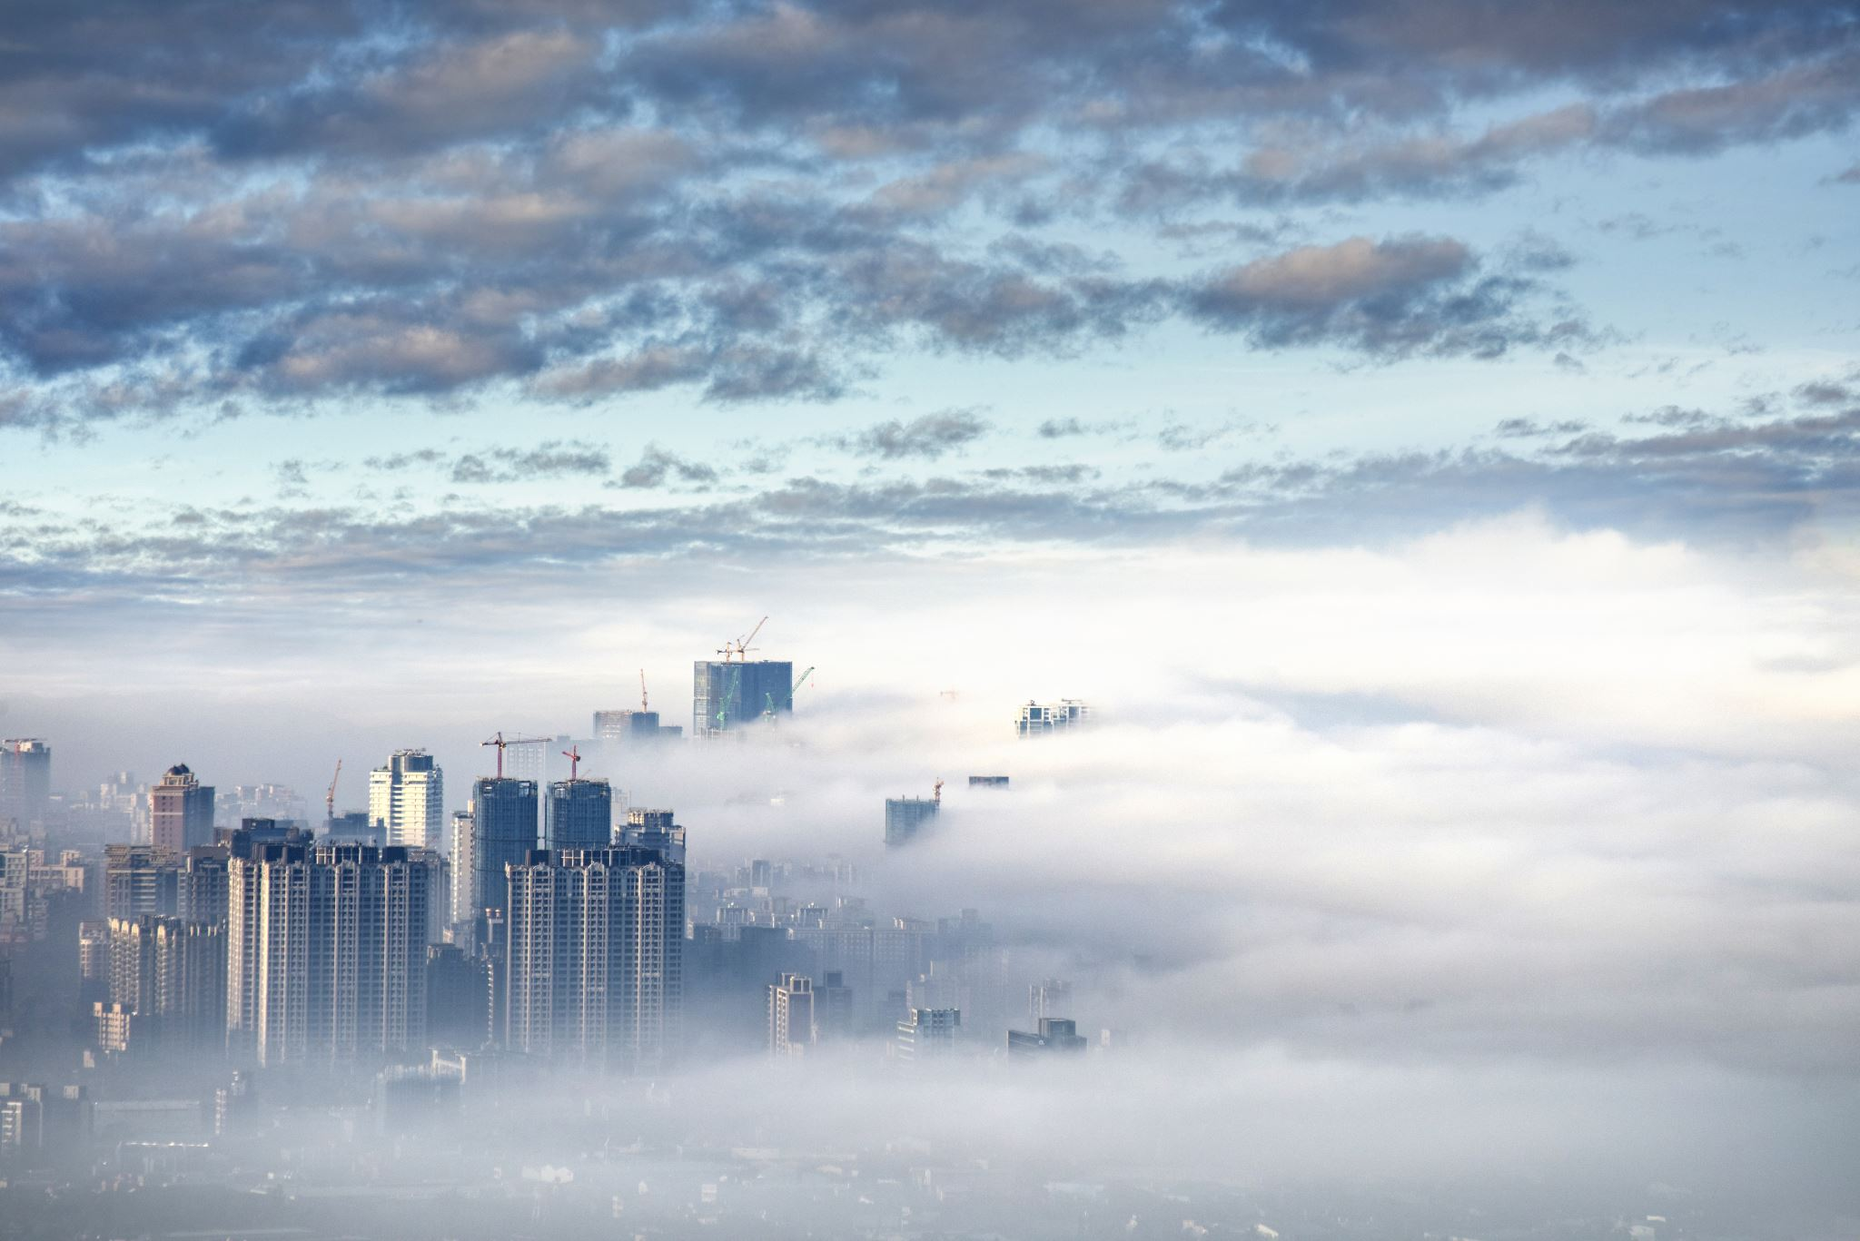
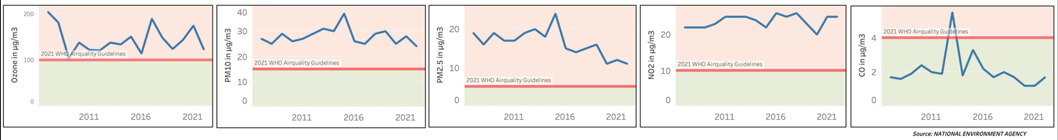
Air Pollution Management
Importance:
Air pollution is a risk to health of people and environmental quality and its management is a critical concern.
Challenge:
A densely populated country like Singapore with high levels of traffic and huge industrial sector, managing air pollution can be a real challenge.
Continuous Quality Monitoring:
Singapore also has an air quality monitoring system, the Pollutant Standards Index (PSI) to provide real-time information on air quality.
Annual Air Quality vs WHO Guidelines:
Comparison of Singapore's air pollutant levels (2007-2022) with the latest 2021 WHO AQG (World Health Organization Air Quality Guidelines) standards to assess air pollution.
Fact: Singapore is the 77th best country in the world in terms of air quality.

Slide 10
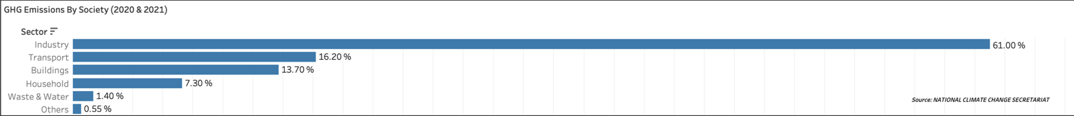
Greenhouse Gas Emissions by Sectors
Emissions Overview:
The highest GHG emissions are from the sectors - industry and transport.
Transport Sector:
Promoting public transport, cycling, walking, and low usage of vehicles.
Reduction Targets:
Singapore has set ambitious goal to reduce their Emissions Intensity by 36 per cent from by 2030.
Policy Measures:
Introducing carbon taxes, renewable energy incentives, and efficiency standards.
Industrial Innovation: Encouraging green technology and sustainable practices in manufacturing.

Slide 11
My Suggestions for Singapore
Incentives for Clean Technology
Industries that invest in clean technologies and continuous monitoring of their emissions can be offered tax incentives, grants, and subsidies to industries.
Invest in Research
Allocate significant funding for research into new technologies and methods for reducing air pollution and GHG emissions, including renewable energy, battery storage technology, and sustainable urban planning.
Reducing Air pollution from Ports
Invest in smart technologies such as supply chain management, travel route planning to optimize sea trading.
People who choose to drive electric vehicles, can be offered some tax incentives. Businesses like taxis can be offered incentives for choosing electric vehicles as well.
Switch to low-sulfur fuel alternatives or a newer technology called “On-Shore electricity”. Shore power cuts air pollution from ships at berth by 95 percent and can be implemented in Singapore.

Slide 12
Water Management Strategies
Singapore is one of the most water-stressed country in the world, but it also acts as an example for how cities can thrive even under most scare conditions by employing proper techniques.
Rainwater Harvesting
Extensive system to collect rainwater, crucial in tropical Singapore.
86% of residents live in high-rise buildings with rooftop collection systems.
17 reservoirs, mostly artificial, supported by a network of drains and canals.
Desalination
Converts seawater to drinkable water using reverse osmosis.
First plant built in 2005; now has 5 plants contributing to 37% of daily water needs.
NEWater
Recycles used water, providing a sustainable source – usually used for industrial and commercial uses.
First built in 2000, now has 5 plants.
More cost-efficient than desalination, covers 40% of daily needs currently and aiming for 55% by 2060.

Slide 13
My Suggestions for Singapore
Community-Based Water Recycling Systems
Instead of collecting water from various regions and recycling the water together. The government could implement small-scale water treatment plants at community-level.
Solar-powered plants
The community level plants mentioned before, are used to recycle smaller scales of water and if possible, could be powered by solar power, reducing the carbon footprint associated with water production.
Underground Water Reservoirs
Investigate about the feasibility of constructing underground reservoirs which can store excess rainwater and treated water.
In these plants, graywater (from showers, sinks, and laundry) can be treated and reused for non-potable purposes such as flushing toilets, gardening, and cleaning, reducing the demand on the main water supply.
This would help maximize space usage in land-scarce Singapore and ensuring a stable water supply during dry periods.

Slide 14

Conclusion Singapore’s Environmental Management
Proactive approach in balancing urban development with sustainability.
Effective land allocation, innovative waste management, and strict air and water conservation strategies.
Transition towards cleaner energy and enhancing public transport systems.
Promotion of green urban living as a step towards a sustainable future.
Identification and continuous efforts in reducing industrial and transport sector emissions.
Commendable vision by Singapore government – to have started focusing on policies that benefit the environment since before 2000.
Serves as a global example of urban sustainability and ecological preservation.
Highlights the potential for high quality of life while caring about the environmental health and sustainability.

